Slide 1
H-1 (EB) Improvements Ola Lane to Likelike Highway Off-Ramp

Slide 2
Project Purpose:
Improve Safety
Relieve Congestion

Slide 5
Widen H1 Eastbound on Makai side
Kalihi Waena Elementary School
Add inside and outside shoulders, increase lane width to 11’
Construct retaining walls
Lengthen Gulick Bridge on the makai and mauka sides

Slide 6
Current Closures
H-1 eastbound between Ola Lane and Likelike Highway
2 lanes closed within the project limits on Sunday nights through Thursday nights, from 8 p.m. to 4:30 a.m., and two lanes closed on Friday nights and Saturday nights from 8 p.m. to 7 a.m.
Gulick Avenue Overpass
1 lane closured on Gulick Avenue overpass bridge between 8 a.m. and 3:30 p.m. Monday through Friday.
Flaggers monitor and maintain alternating traffic control. They are aware of the Kalihi Waena pick ups around 2:20 p.m.
Notes:
We are in
Phase 1 (H1 Eastbound): Close existing shoulders on H1 and demolish the existing retaining walls within the project area. Relocate highway lighting and install temporary lighting. Install new drainage structures along H1, construct new retaining walls, widen roadway pavement on H1, and install new cantilever sign structures and ITS equipment.

Slide 7
Project Status:
$100M Project
Construction started January, 2024
Approx. 25% complete to date (H1 Retaining Wall construction completed up to Richard Lane area; Dry utility relocation ongoing on Gulick)
Substantial Completion: End of 2026
Project Milestones:
Eastbound 36” waterline tie-in on freeway start: June, 2025
Westbound 36” waterline tie-in on freeway start: July, 2025
Temporary pedestrian bridge installation start: September, 2025
Gulick Drilled Shaft work start: September, 2025 (2-month closure)
Gulick full structural work start: March, 2026 (5-month closure)
Notes:
We are in
Phase 1 (H1 Eastbound): Close existing shoulders on H1 and demolish the existing retaining walls within the project area. Relocate highway lighting and install temporary lighting. Install new drainage structures along H1, construct new retaining walls, widen roadway pavement on H1, and install new cantilever sign structures and ITS equipment.

Slide 8
Gulick Avenue Overpass
Lengthen existing bridge and move abutments on the WB and EB sides about 15.5’ each
Build retaining walls on the WB and EB side

Slide 10
(11) 5-foot diameter shafts Makai, and (10) shafts Mauka

Slide 11
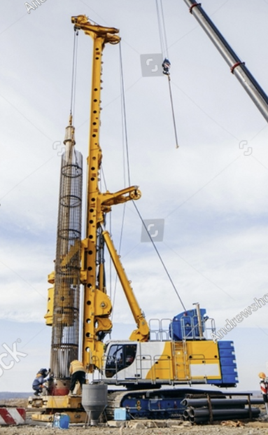
Partial lane closures continue between 7a-4p. A lot of utility relocation work to start that will require single lane closures that will alternate directions for the next year.
Temporary ACROW pedestrian bridge will be installed around the end of September 2025 connecting Kalihi Waena park to mauka side of the freeway.
Full Closure for drilled shaft installation approximate September through early November 2025.
Back to Partial Closure approximate December through February 2026 for P/T duct installation work.
Then full closure of bridge from approximate March 2026 through Sep 2026 for structural elements of the bridge work.
After this major work, we will be back to the 7-4p to finish up paving/close-out, etc through end of 2026.

Slide 12
Detour while Gulick OP is closed

Slide 13
H-1 lane closures for the waterline tie-in work:
24-hour 1-2 lane closures on the H1 over (6) weekends in mid 2025 to complete 36-inch waterline tie in (3 weekends EB, 3 weekends WB).

Slide 14
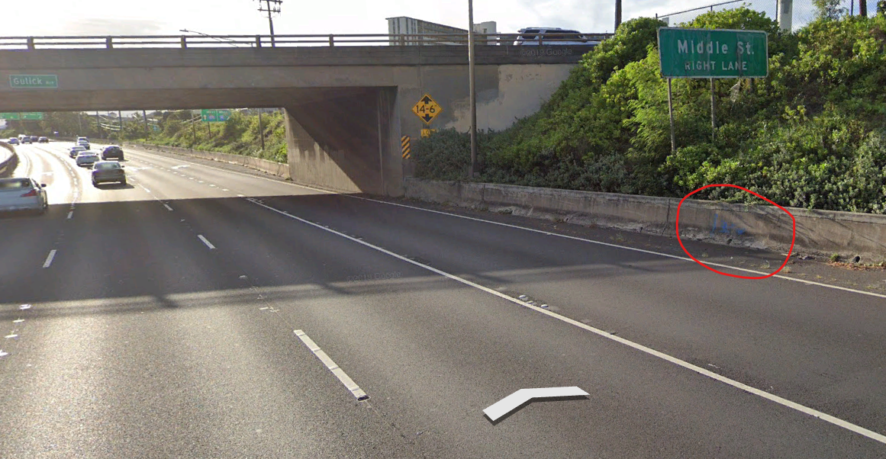
H1 Westbound:

Slide 15
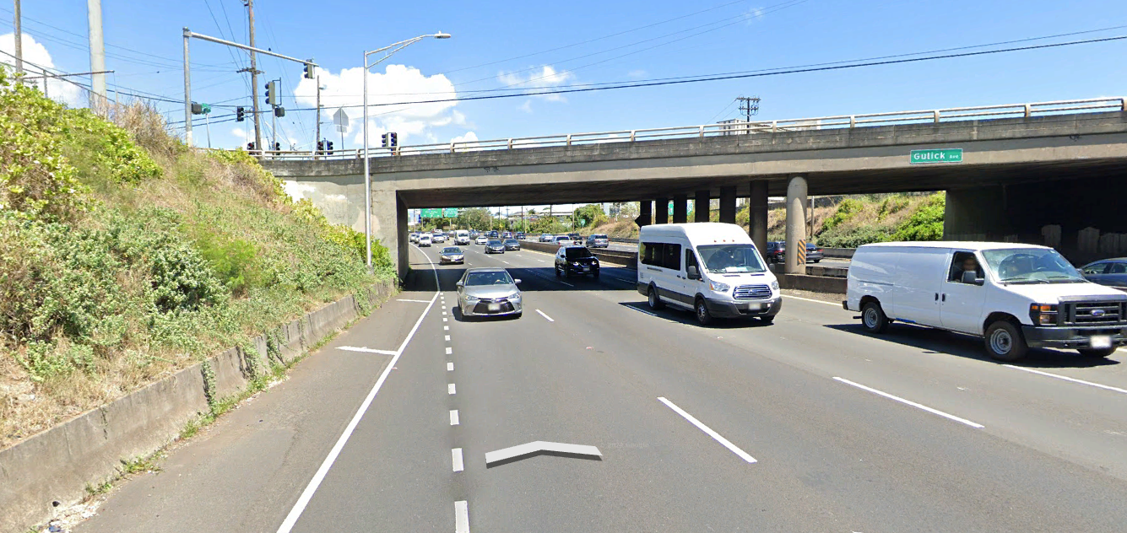
H1 Eastbound:

Slide 16
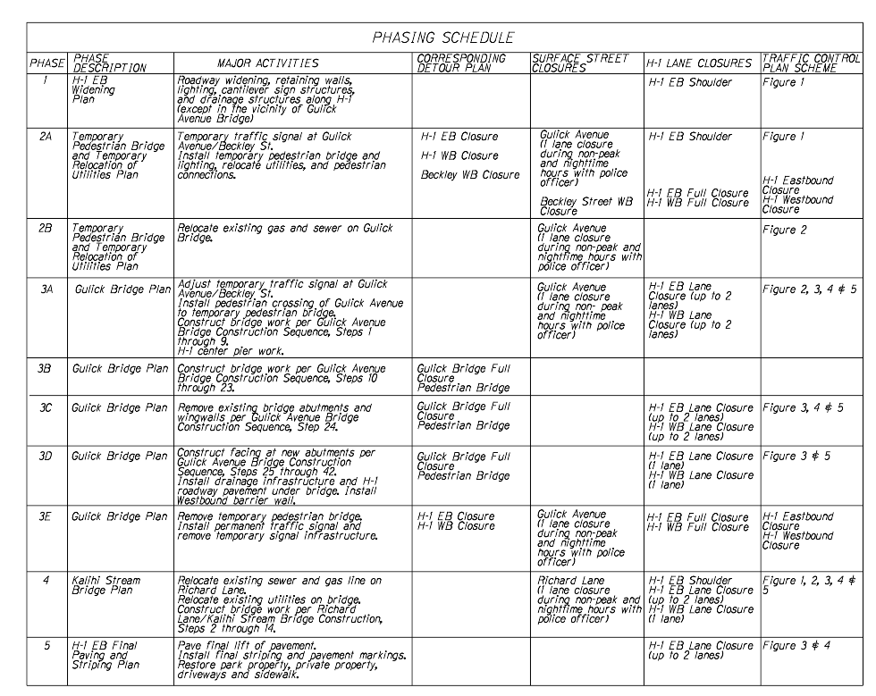
H1 Full Closures
Two weekend full closures will be needed for installation and removal of the temporary pedestrian bridge.
Times for the weekend full closures:
Saturday 8 p.m. to midnight
Sunday midnight to 8 a.m.
Notes:
Phase 5 (H1 Eastbound Paving and Striping): Pave final lift of H1 pavement section. Remove existing
striping and install final striping and pavement markings to match improvements. Restore driveways,
sidewalks, school property (including landscaping and parking lot paving), and private properties
within the work zone.

Slide 17
Work at Gulick Avenue
Notes:
Phase 2 (Temporary Pedestrian Bridge and Temporary Relocation of Utilities): Close the east side of the Gulick Avenue bridge to vehicular traffic as necessary to implement a staging area. Install temporary lighting and a temporary pedestrian bridge with connections to existing sidewalks/access
across H1. For safety reasons, full closure of H1 is anticipated when pedestrian bridge construction occurs over travel lanes. Relocate existing utilities to the temporary pedestrian bridge, if possible. Shut off and relocate water, gas, and sewer. Install temporary traffic signal at the Gulick Avenue/Beckley Street intersection.
Phase 3 (Gulick Avenue Bridge): Close Gulick Avenue bridge to all vehicular and nonmotorized traffic. Relocate pedestrian crossings for safe access to the temporary pedestrian bridge. Demolish or remove existing bridge components and construct new bridge extension, sidewalks, and railings. Remove existing abutments and wingwalls on the mauka and makai sides of H1, and construct concrete facing at the new abutments. Install permanent traffic signal at the Gulick Avenue/Beckley Street intersection. Remove temporary pedestrian bridge and restore disturbed areas.

Slide 18
Widen H1 over Richard Lane and Kalihi Valley Stream
Notes:
Traffic will contraflow through Richard Lane during construction activities. The only shutdown will occur during the placement of the precast plank for safety reasons. The shutdown will take place overnight and last about 30 minutes.
Phase 4 (Kalihi Stream Bridge): Relocate utilities on Richard Lane and along the outside of H1 traffic barrier at Kalihi Stream bridge prior to bridge pier construction. Install temporary in-stream isolation and containment barriers. Close outside lanes on H1 and install new Kalihi Stream bridge components.
Demolish existing freeway bridge railing and connect the new bridge to the existing superstructure. Remove temporary in-stream barriers.

Slide 19
Any Questions?

